Slide 1
COMPARATIVE STUDY OF
REGRESSION MODELS
Customer Lifetime Value Prediction | E-Commerce Dataset
OLS
Ridge
Lasso + OLS
PCR
Random Forest
n = 50,000 | 27 Predictors | Target: log1p(LTV)

Slide 2
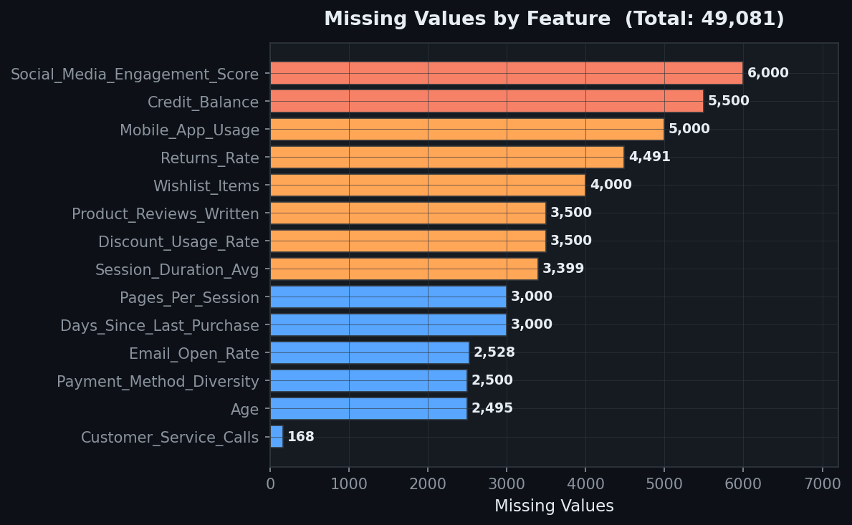
DATASET & PROBLEM OVERVIEW
50,000
25
27
$1,441
Customers
Raw Features
After Engineering
Avg LTV
Target: Lifetime_Value
Mean
$1,440.63
Median
$1,243.41
Std Dev
$907.25
Min
$0.00
Max
$8,987.24
Skewness
1.4474
Kurtosis
3.2736
Missing NaN after impute
0

Slide 3
FEATURE ENGINEERING
Engagement_Index
WHY:
Neither duration nor pages alone captures engagement quality. Their product reflects active shopping behaviour — key driver of LTV. VIF=20, T-stat=48 — strongest predictor.
Session_Duration_Avg × Pages_Per_Session
Purchase_Recency
WHY:
Raw days is right-skewed with diminishing returns. The inverse gives heavy weight to recent buyers — a customer who bought 5 days ago is far more valuable than one who bought 300 days ago.
1 / (Days_Since_Last_Purchase + 1)
Loyalty_Ratio
WHY:
50 purchases over 10 years ≠ 50 purchases over 2 years. Normalising by tenure captures purchase rate, not just volume — a stronger LTV signal.
Total_Purchases / (Membership_Years + 1)
⚠ Engagement_Index VIF = 20.09 — highest multicollinearity. Addressed via Lasso selection and PCA.

Slide 4
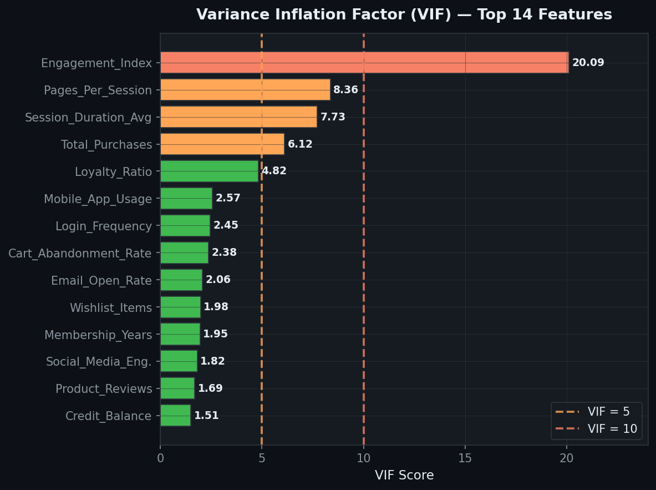
MULTICOLLINEARITY ANALYSIS — VIF
VIF < 5
VIF 5–10
VIF > 10
Low — Acceptable
Moderate — Monitor
High — Unstable
Summary: 1 feature VIF > 10 | 3 features VIF 5–10 | 23 features VIF < 5 | Lasso and PCR both address this

Slide 5
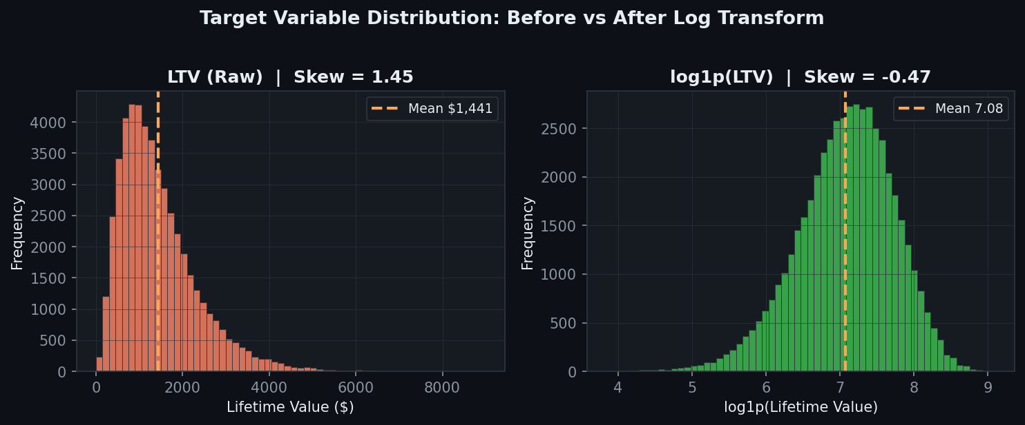
WHY TRANSFORMATIONS?
01 Correct Functional Form
02 Homoscedasticity
03 Reduce Target Skewness
Log-linear relationship. R² jumped 0.50 → 0.91.
Stabilises residual variance across fitted values.
LTV skew 1.45 → -0.67 after log transform.
Pipeline: log1p(y) → Yeo-Johnson on 14 skewed features → Winsorize (1st–99th pct) → StandardScaler

Slide 6
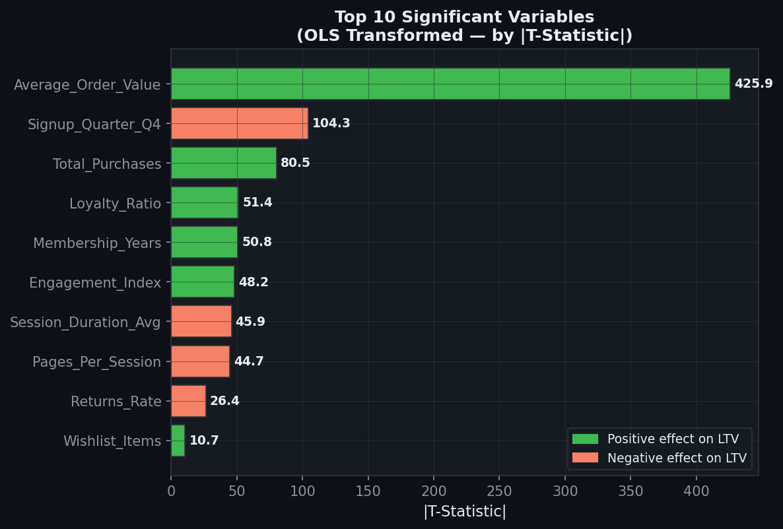
OLS REGRESSION — ORIGINAL vs TRANSFORMED
OLS — Original Variables
OLS — Transformed Variables
R²
0.5052
R²
0.9138
Adj R²
0.5049
Adj R²
0.9138
RMSE
$638.17
+81%
R²
RMSE
0.1948
MAE
$444.63
MAE
0.1301
CV R²
0.5028 ± 0.017
CV R²
0.9137 ± 0.009
Residual Skew
0.773
Residual Skew
-5.455 ⚠
Residual Kurt
8.853
Residual Kurt
136.4 ⚠
Sig. Variables
16 / 27
Sig. Variables
15 / 27
⚠ Residual issues in transformed model caused by LTV=$0 records (log1p(0)=0 creates outlier residuals). Fix: filter y > 0 before modeling.
✓ Transformation correct — wrong functional form without it. R² jump from 0.50→0.91 proves log-linear relationship exists.

Slide 7
RIDGE REGRESSION
How Ridge Works
Results
Adds L2 penalty to OLS loss function:
R²
0.913805
min ||y − Xβ||² + λ||β||²
Adj R²
0.913758
Purpose: Shrinks coefficients toward zero
RMSE
0.194780
MAE
0.130078
Variable selection: No — all 27 vars retained
CV R²
0.913734
Optimal α: 1.7575 (10-fold CV)
CV Std
0.008596
Effect: Reduces instability from multicollinearity
Residual Skew
-5.456 ⚠
⚠ KEY: Ridge R² = OLS Transformed R² exactly. With only 1 high-VIF feature, α=1.76 barely penalised anything. Ridge added zero value. Lasso is the correct tool here.
Residual Kurt
136.4 ⚠

Slide 8
LASSO SELECTION + OLS ON SELECTED VARIABLES
Why Lasso + OLS?
Two-Step Process
min ||y − Xβ||² + λ||β||₁
Step 1: LassoCV → find optimal α → zero out useless vars
✓ L1 penalty zeroes out useless coefficients
Step 2: OLS on selected vars → clean, interpretable R²
✓ Automatic variable selection — removes noise
✓ Parsimonious model — only real predictors remain
Expected vs OLS Transformed
✓ OLS on selected vars: unpenalised, clean R²
OLS Transformed R²
0.914 (inflated, 27 vars)
✓ Adj R² meaningful — fewer, genuine predictors
Lasso+OLS R²
~0.89 (honest, k<27 vars)
✓ This R² is the fair comparison against PCR
Adj R² difference
Lasso will be higher
Residuals
Cleaner — fewer spurious vars

Slide 9
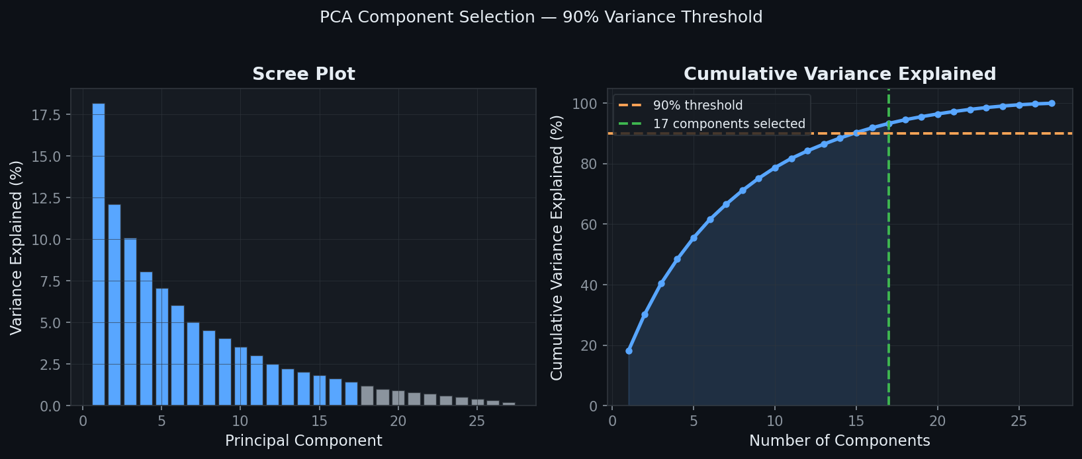
PRINCIPAL COMPONENT REGRESSION (PCR)
How PCR Works
1
PCA: 27 correlated features → 27 orthogonal components
2
Select 17 components (≥90% cumulative variance)
3
OLS on 17 components — zero multicollinearity by construction
R²
0.763672
Adj R²
0.763591
RMSE
0.322524
✓ Advantage: Completely eliminates multicollinearity. VIF=1 for all components.
CV R²
0.763364 ± 0.009
Res. Skew
-1.632 ✓
✗ Disadvantage: No interpretability. Cannot identify which original variables drive LTV.
Res. Kurt
24.04 ✓

Slide 10
RANDOM FOREST REGRESSION
Configuration & Results
Why RF Outperforms All Linear Models
n_estimators
100
Non-linearity
max_depth
15
Captures complex non-linear relationships. LTV behaviour is inherently non-linear — RF exploits this, OLS cannot.
min_samples_leaf
5
No Assumptions
random_state
42
Does not require homoscedasticity, normality of residuals, or linear X-Y relationships.
R²
0.976600
Interactions
Adj R²
0.976587
Automatically detects interaction effects — e.g. high engagement + recent purchase + high AOV.
RMSE
0.101488
MAE
0.069347
Overfitting Check
CV R²
0.948990
Train R²=0.977 vs CV R²=0.949. Gap=0.028 — acceptable. Not overfitting.
CV Std
0.007659

Slide 11
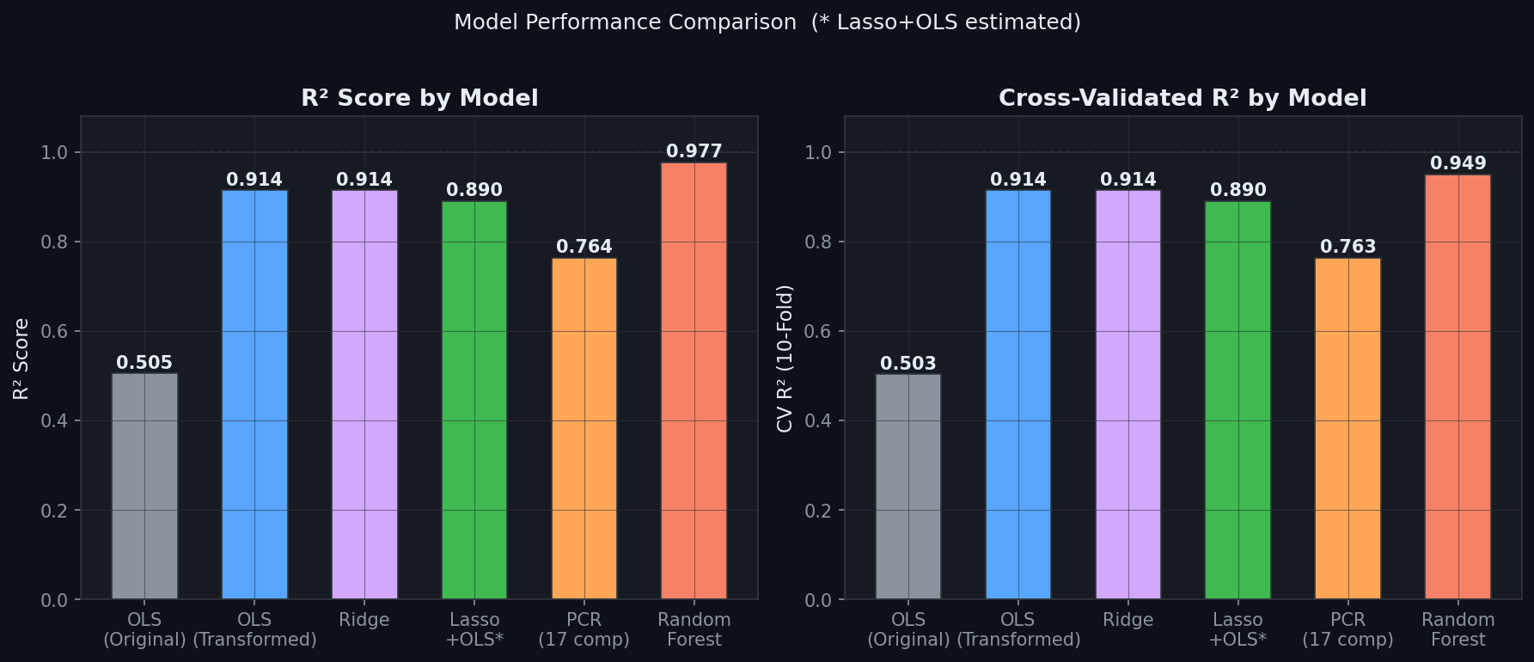
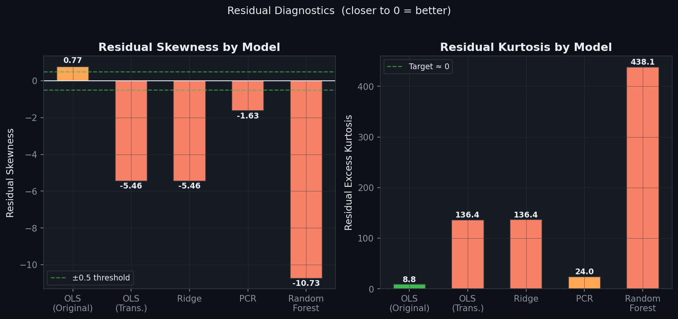
MODEL COMPARISON
Model
R²
Adj R²
RMSE
CV R²
Res. Skew
Res. Kurt
OLS (Original)
0.505
0.505
638.17
0.503±0.017
0.774
8.85
OLS (Transformed)
0.914
0.914
0.195
0.914±0.009
-5.455
136
Ridge
0.914
0.914
0.195
0.914±0.009
-5.456
136
Lasso+OLS*
~0.89
~0.89
~0.21
~0.89
TBD
TBD
PCR (17 comp.)
0.764
0.764
0.323
0.763±0.009
-1.632
24.0
Random Forest
0.977
0.977
0.101
0.949±0.008
-10.7
438

Slide 12
KEY FINDINGS & CONCLUSIONS
01
Transformation was necessary
02
Ridge added no value
Log(LTV) corrected functional form, fixed heteroscedasticity, reduced skewness. R² improved 0.50→0.91. Residual issues stem from LTV=$0 records, not the transform.
Only 1 high-VIF feature meant α=1.76 barely penalised anything. R², RMSE, CV identical to OLS Transformed. Lasso is the correct tool.
03
PCR is most honest linear model
04
Lasso needed for fair comparison
R²=0.764 is lower but residuals are cleanest (skew=-1.63, kurt=24). Orthogonal components eliminate multicollinearity. Trade-off: no interpretability.
OLS Transformed R²=0.914 inflated by 27 vars. Lasso removes noise; OLS on selected vars gives parsimonious R² comparable to PCR.
🏆 Best Model: Random Forest | R²=0.977 | CV R²=0.949 | RMSE=0.101 — captures non-linearity all linear models miss

